Slide 1
Unit III

Slide 2
Syllabus
De Morgan’s Theorem, Adders, Multiplier – Unsigned, Signed, Fast, Carry Save Addition of summands; Division–Restoring and Non-Restoring; IEEE 754 Floating point numbers and operations.

Slide 3
De Morgan’s Theorem
It is a very powerful tool used in digital design
De Morgan’s theorem are used to solve the expressions of Boolean Algebra.
It gives relation between union, complement and intersection in set theory.
The theorem explains that the complement of the product of all the
terms is equal to the sum of the complement of each term.
Likewise, the complement of the sum of all the terms is equal to the product of the complement of each term.
There are 2 laws: first De Morgan’s law and Second De Morgan’s law.

Slide 4

Two Theorems
Theorem1
The left hand side (LHS) of this theorem represents a NAND gate with inputs A and B, whereas the right hand side (RHS) of the theorem represents an OR gate with inverted inputs.
This OR gate is called as Bubbled OR.

Slide 5
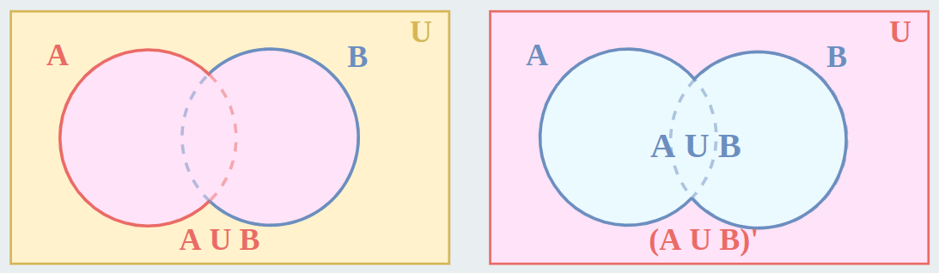
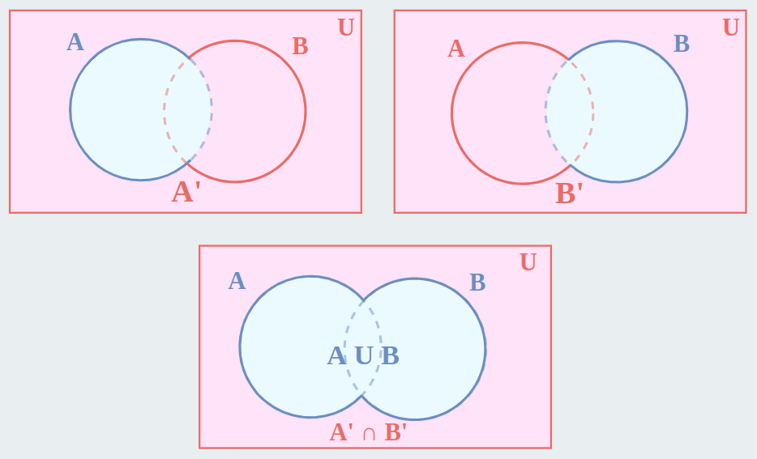
Venn diagram proof (First theorem)
(AUB)’
A’ + B’

Slide 6
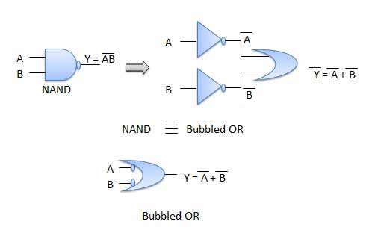
Theorem1 – Logic diagram

Slide 7
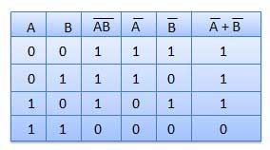
Table showing verification of the De Morgan's first theorem

Slide 8

Theorem 2
The LHS of this theorem represents a NOR gate with inputs A and B, whereas the RHS represents an AND gate with inverted inputs.
This AND gate is called as Bubbled AND.

Slide 9
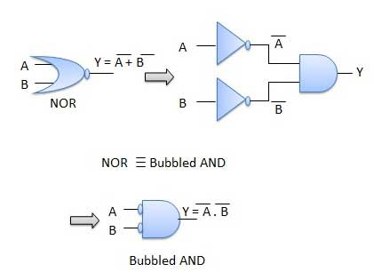
Theorem 2- Logic diagram

Slide 10
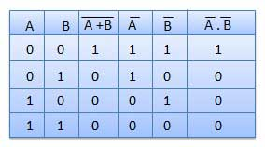
Table showing verification of the De Morgan's second theorem

Slide 11
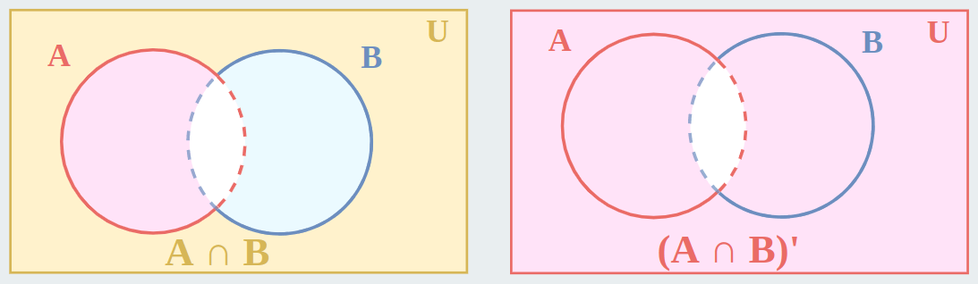
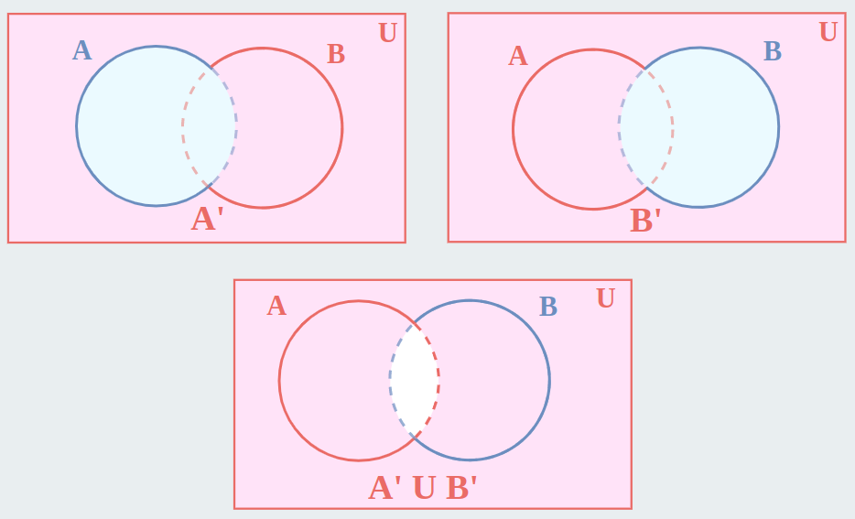
Theorem 2

Slide 12
Applications of De Morgan’s Theorem
In the domain of engineering, using De Morgan’s laws, Boolean expressions can be built easily only through one gate which is usually NAND or NOR gates. This results in hardware design at a cheaper cost.
Used in the verification of SAS code.
Implemented in computer and electrical engineering domain.
De Morgan’s laws are also employed in Java programming.

Slide 13
Arithmetic Logic Unit
ALU is the heart of any Central Processing Unit.
A simple ALU is constructed with Combinational circuits.
It is a digital circuit to do arithmetic operations like addition, subtraction, multiplication and division.
Logical operations such as OR, AND, NOR etc.
Data movement operations such as LOAD and STORE.
Complex ALUs are designed for executing Floating point, decimal operations and other complex numerical operations. These are called as Co-processor and work in tandem with the main processor.
The design specifications of ALU are derived from the Instruction set Architecture.
The ALU must have the capabilities to execute the instructions of ISA.
Modern CPUs have multiple ALU to improve the efficiency.

Slide 14
Arithmetic Logic Unit
ALU includes the following Configurations :
- Instruction Set Architecture
- Accumulator
- Stack
- Register – Register architecture
- Register – Stack architecture
- Register – memory architecture
The size of input quantities of ALU is referred as word length of a computer

Slide 15
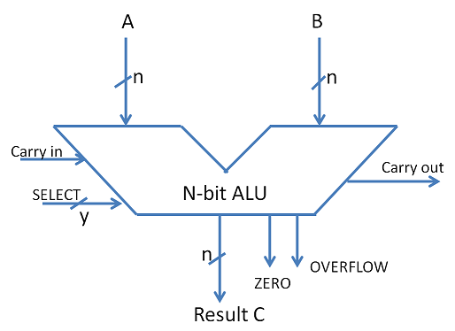
ALU Symbol

Slide 16
ADDERS
The basic building blocks of an ALU in digital computers are Adders.
Types of Basic Adders are
- Half Adder
- Full Adder
Parallel adders are nothing but cascade of full adders. The number of full adders used will depend on the number of bits in the binary digit which require to be added.
Ripple carry adders are used when the input sequence is large. It is used to add two n-bit binary numbers.
Carry look ahead adder is an improved version of Ripple carry adder.
It generates the carry-in of each full adder simultaneously without causing any delay.

Slide 17
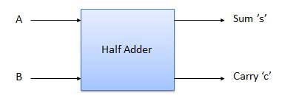
Half Adder
Half adder is a combinational logic circuit with two input and two output. The half adder circuit is designed to add two single bit binary number A and B. It is the basic building block for addition of two single bit numbers. This circuit has two outputs, carry and sum.

Slide 18
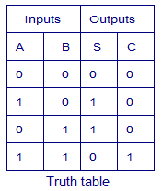

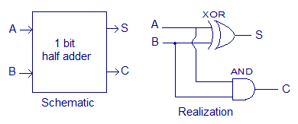
Truth Table and Circuit Diagram
Boolean Expression

Slide 20
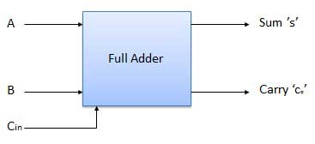
Full Adder
Full adder is developed to overcome the drawback of Half Adder circuit. It can add two one-bit numbers A and B, and carry c. The full adder is a three input and two output combinational circuit.

Slide 21
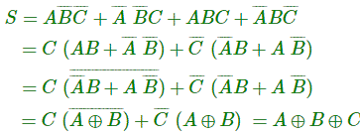

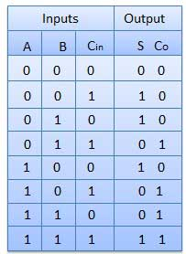
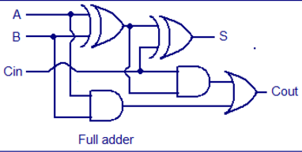
Truth Table and Circuit Diagram

Slide 23
Ripple carry adder (RCA)
Multiple full adders are used for n-bit numbers.
Each full adder has a C_{in}, which is its input and C_{out}, output from previous adder.
Since each carry bit ripples to the next adder, it is called ripple carry adder.
Layout is simple, but it is relatively slow as it has to wait for previous adders output.

Slide 24
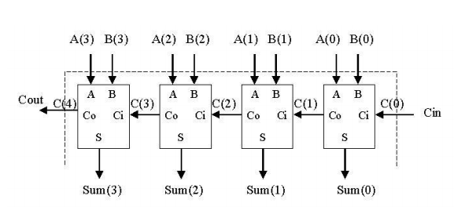

Slide 25
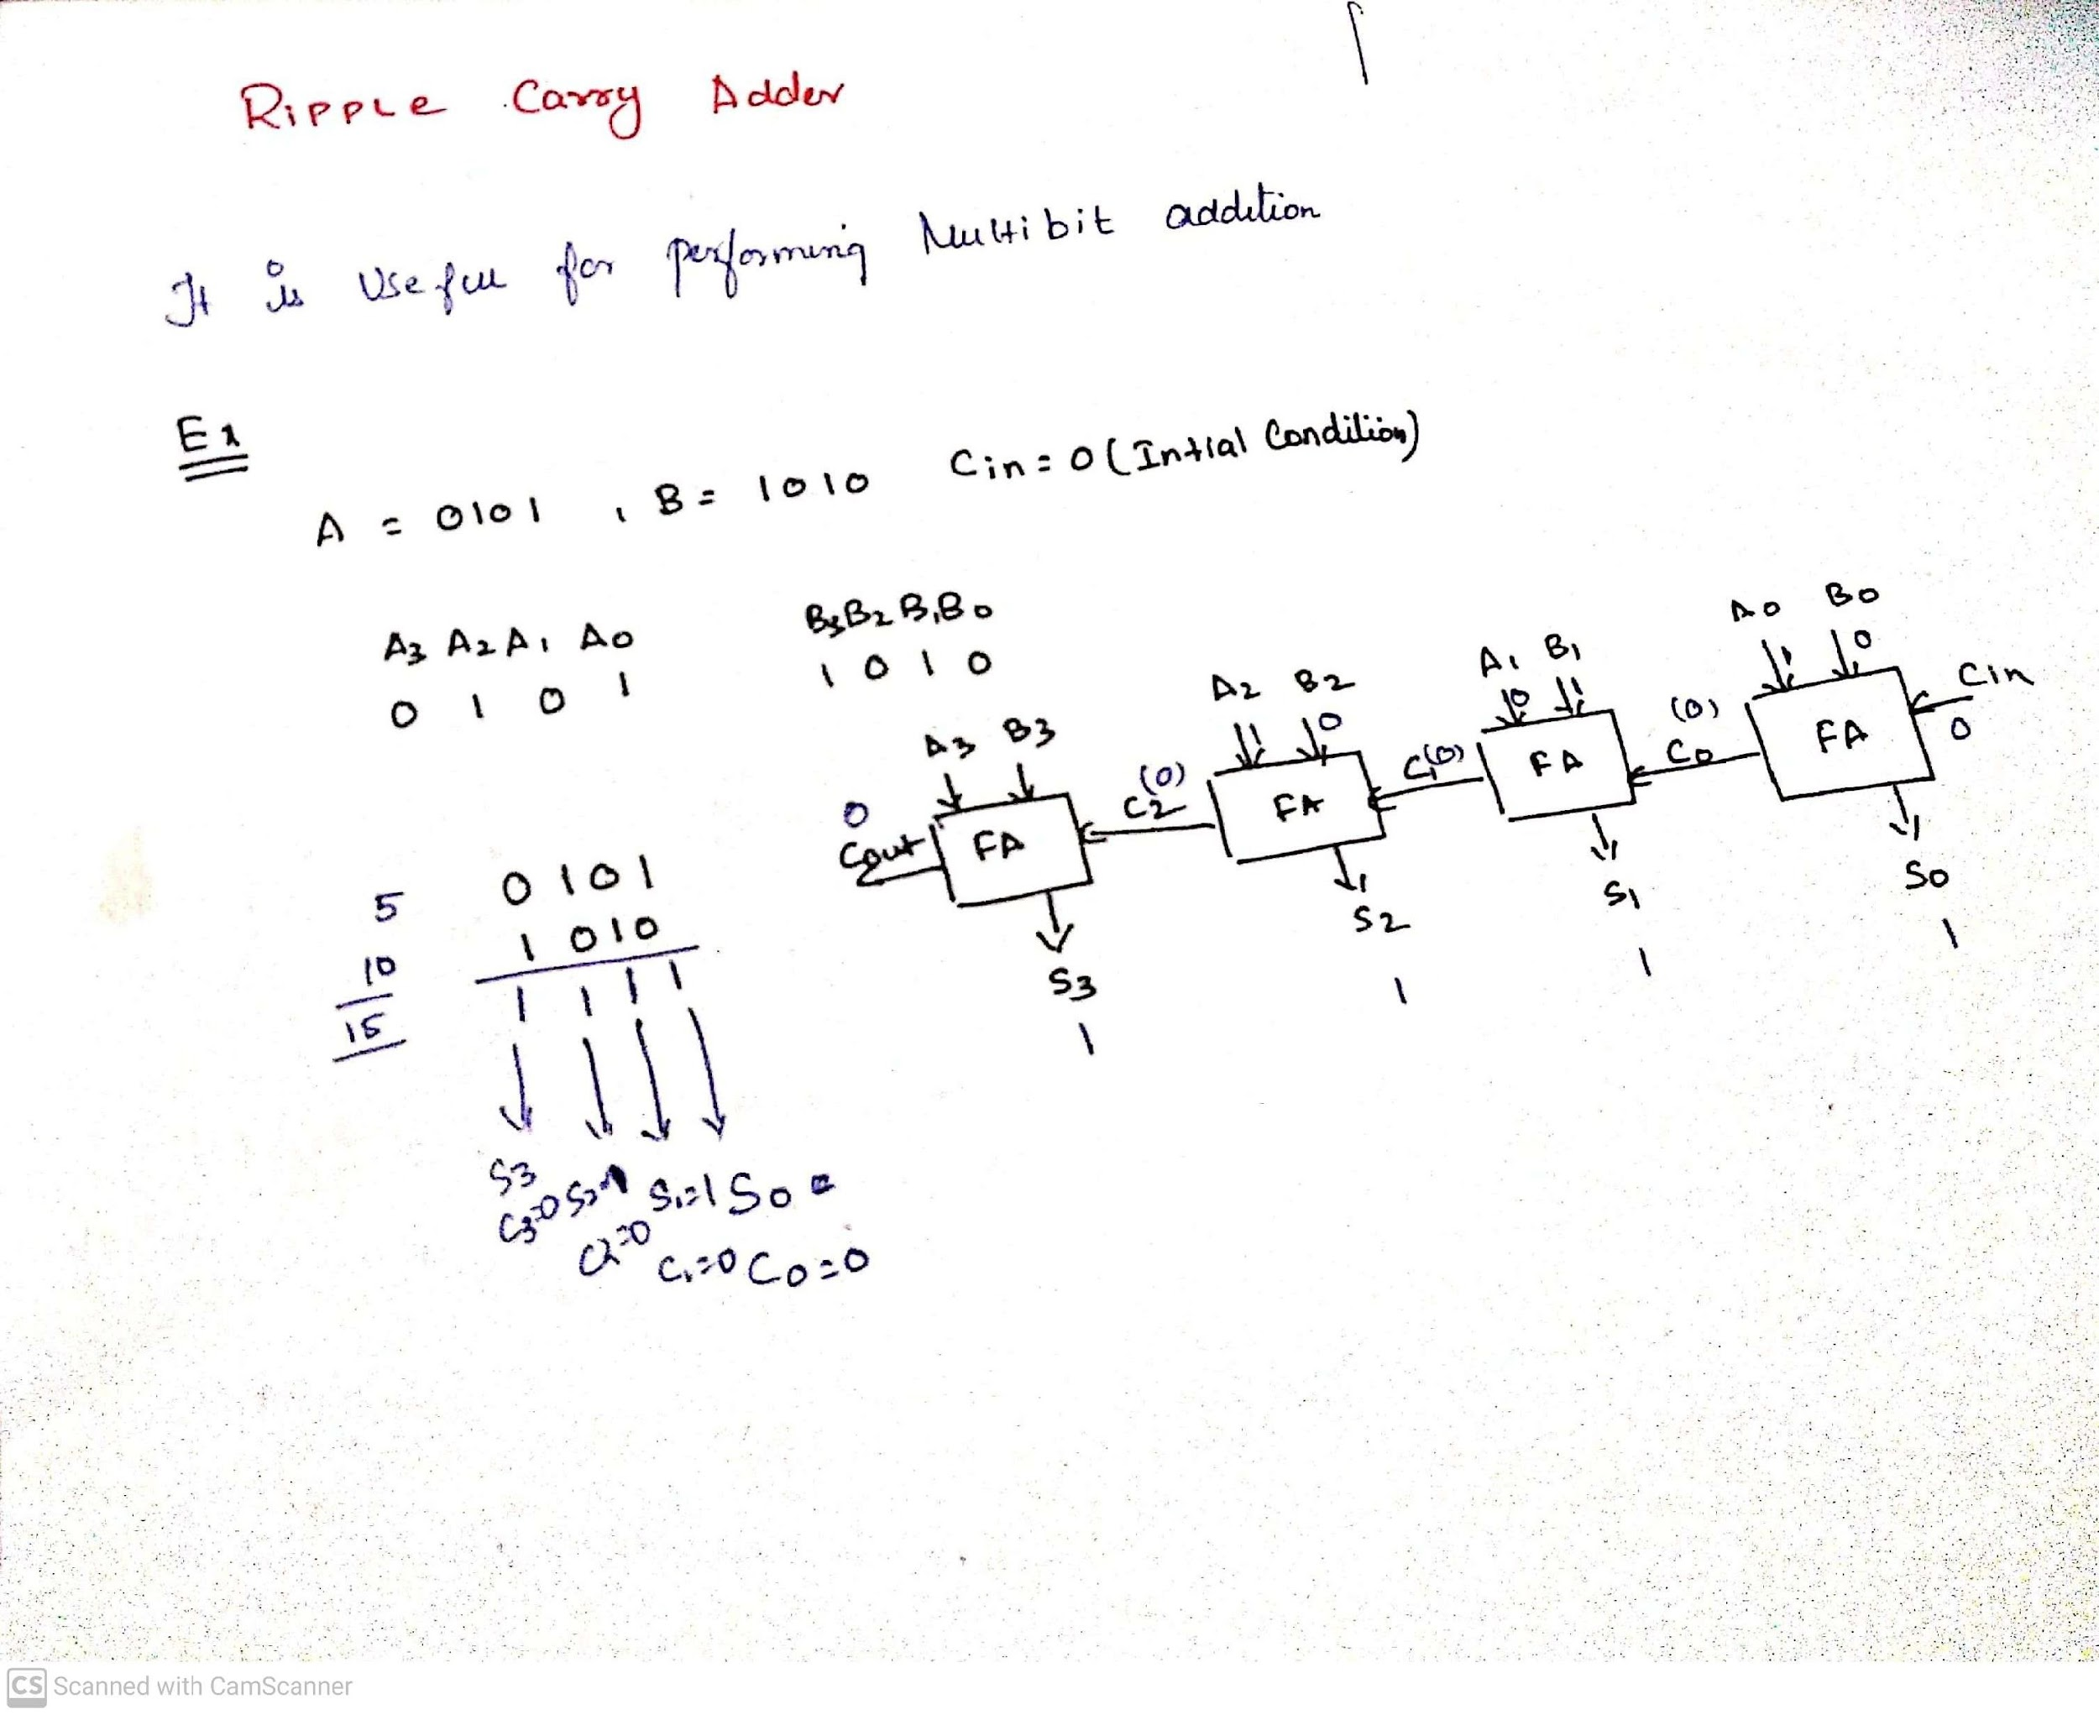

Slide 27
Disadvantages of ripple carry adder
Delay
Since each adder has to wait for the previous adders result.

Slide 28

Carry look ahead adder
Overcomes the disadvantage of ripple carry ahead adder.
Faster adder circuit.
Two signals, P and G are used.
P_{i} -> carry propagate
G_{i} -> carry generate.
A carry is generated based on 2 rules:
When both bits are 1
When 1 bit is 1 and a carry is to be coming for it. (carry in is 1)

Slide 29
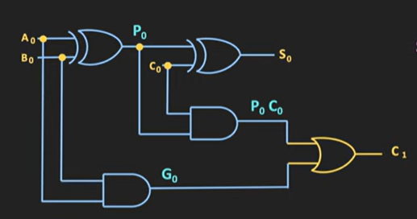

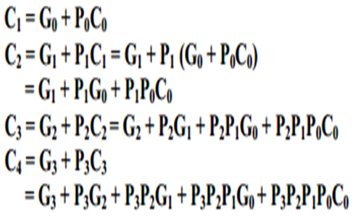
Carry look ahead adder
The output sum and carry are,

Slide 30
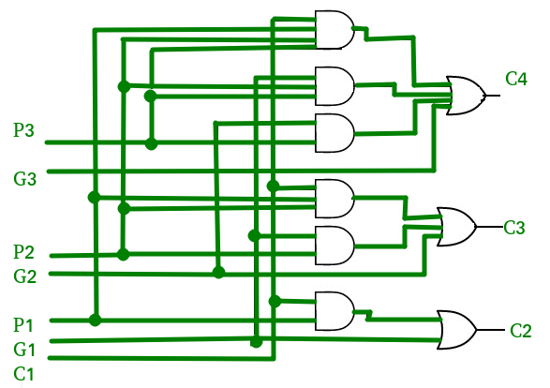
Combinational circuit for Carry look ahead adder

Slide 31
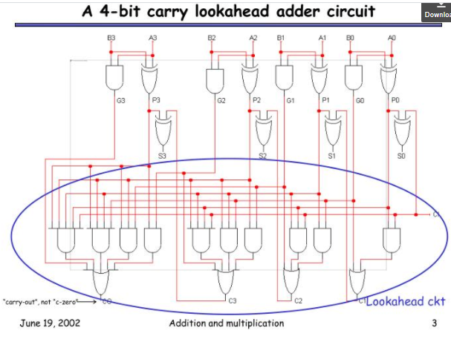
Carry look ahead adder

Slide 32
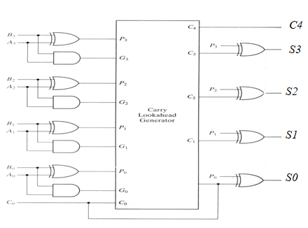

Slide 33
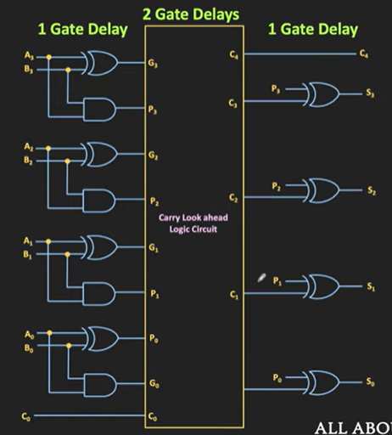

Slide 34
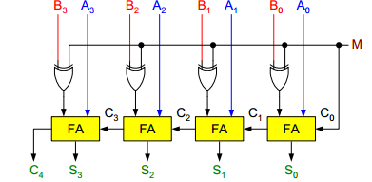
Binary Parallel Adder/Subtractor:
The addition and subtraction operations can be done using an Adder-Subtractor circuit.
The figure shows the logic diagram of a 4-bit Adder-Subtractor circuit.

Slide 35
Binary Parallel Adder/Subtractor:
So when M = 0, the output of XOR gate will be Bi ⊕ 0 = Bi. If the full adders receive the value of B, and the input carry C0 is 0, the circuit performs A plus B.
When M = 1, the output of XOR gate will be Bi ⊕ 1 = Bi. If the full adders receive the value of B’, and the input carry C0 is 1, the circuit performs A plus 1’s complement of B plus 1, which is equal to A minus B.

Slide 36
Multiplier
Multiplies 2 binary nos.
A variety of techniques can be used to implement a digital multiplier.
Common technique is to use partial products, then sum using adder.

Slide 37
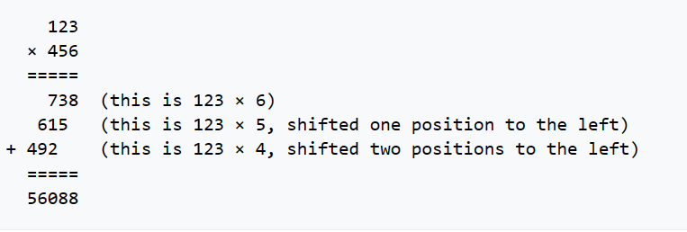

Slide 38
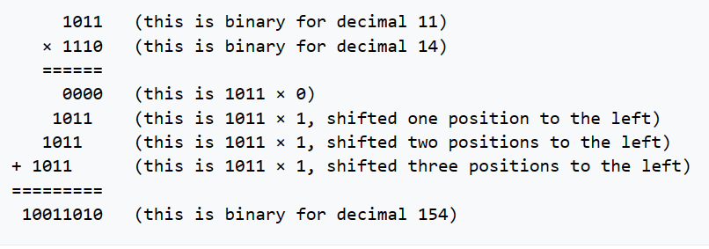

Slide 39
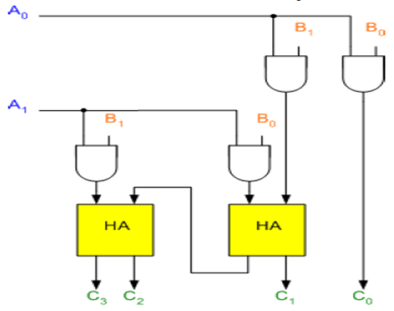
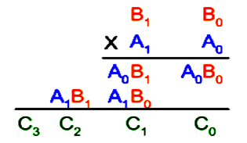
Binary Multiplier

Slide 40

Binary Multiplier
The first partial product is formed by multiplying the B1B0 by A0. The multiplication of two bits such as A0 and B0 produces a 1 if both bits are 1; otherwise it produces a 0 like an AND operation. So the partial products can be implemented with AND gates.
The second partial product is formed by multiplying the B1B0 by A1 and is shifted one position to the left.
The two partial products are added with two half adders (HA). Usually, if there are more bits in the partial products, and then it will be necessary to use FAs.

Slide 41
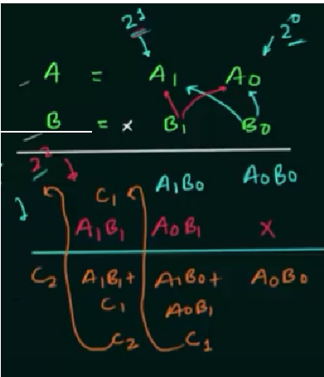
Binary Multiplier

Slide 42
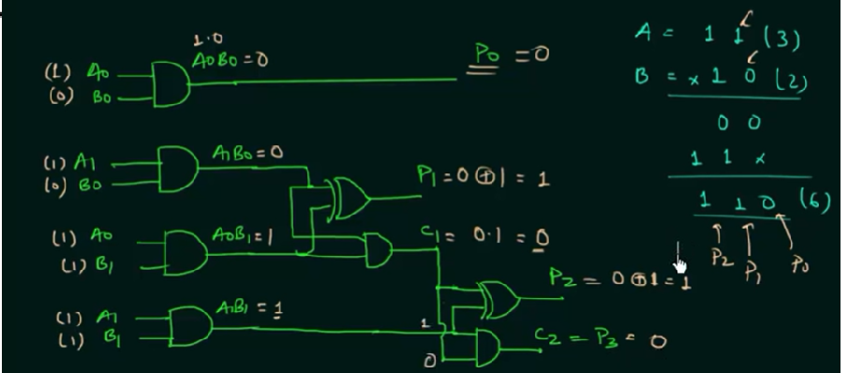
Binary Multiplier

